Slide 1


Slide 7



Slide 8
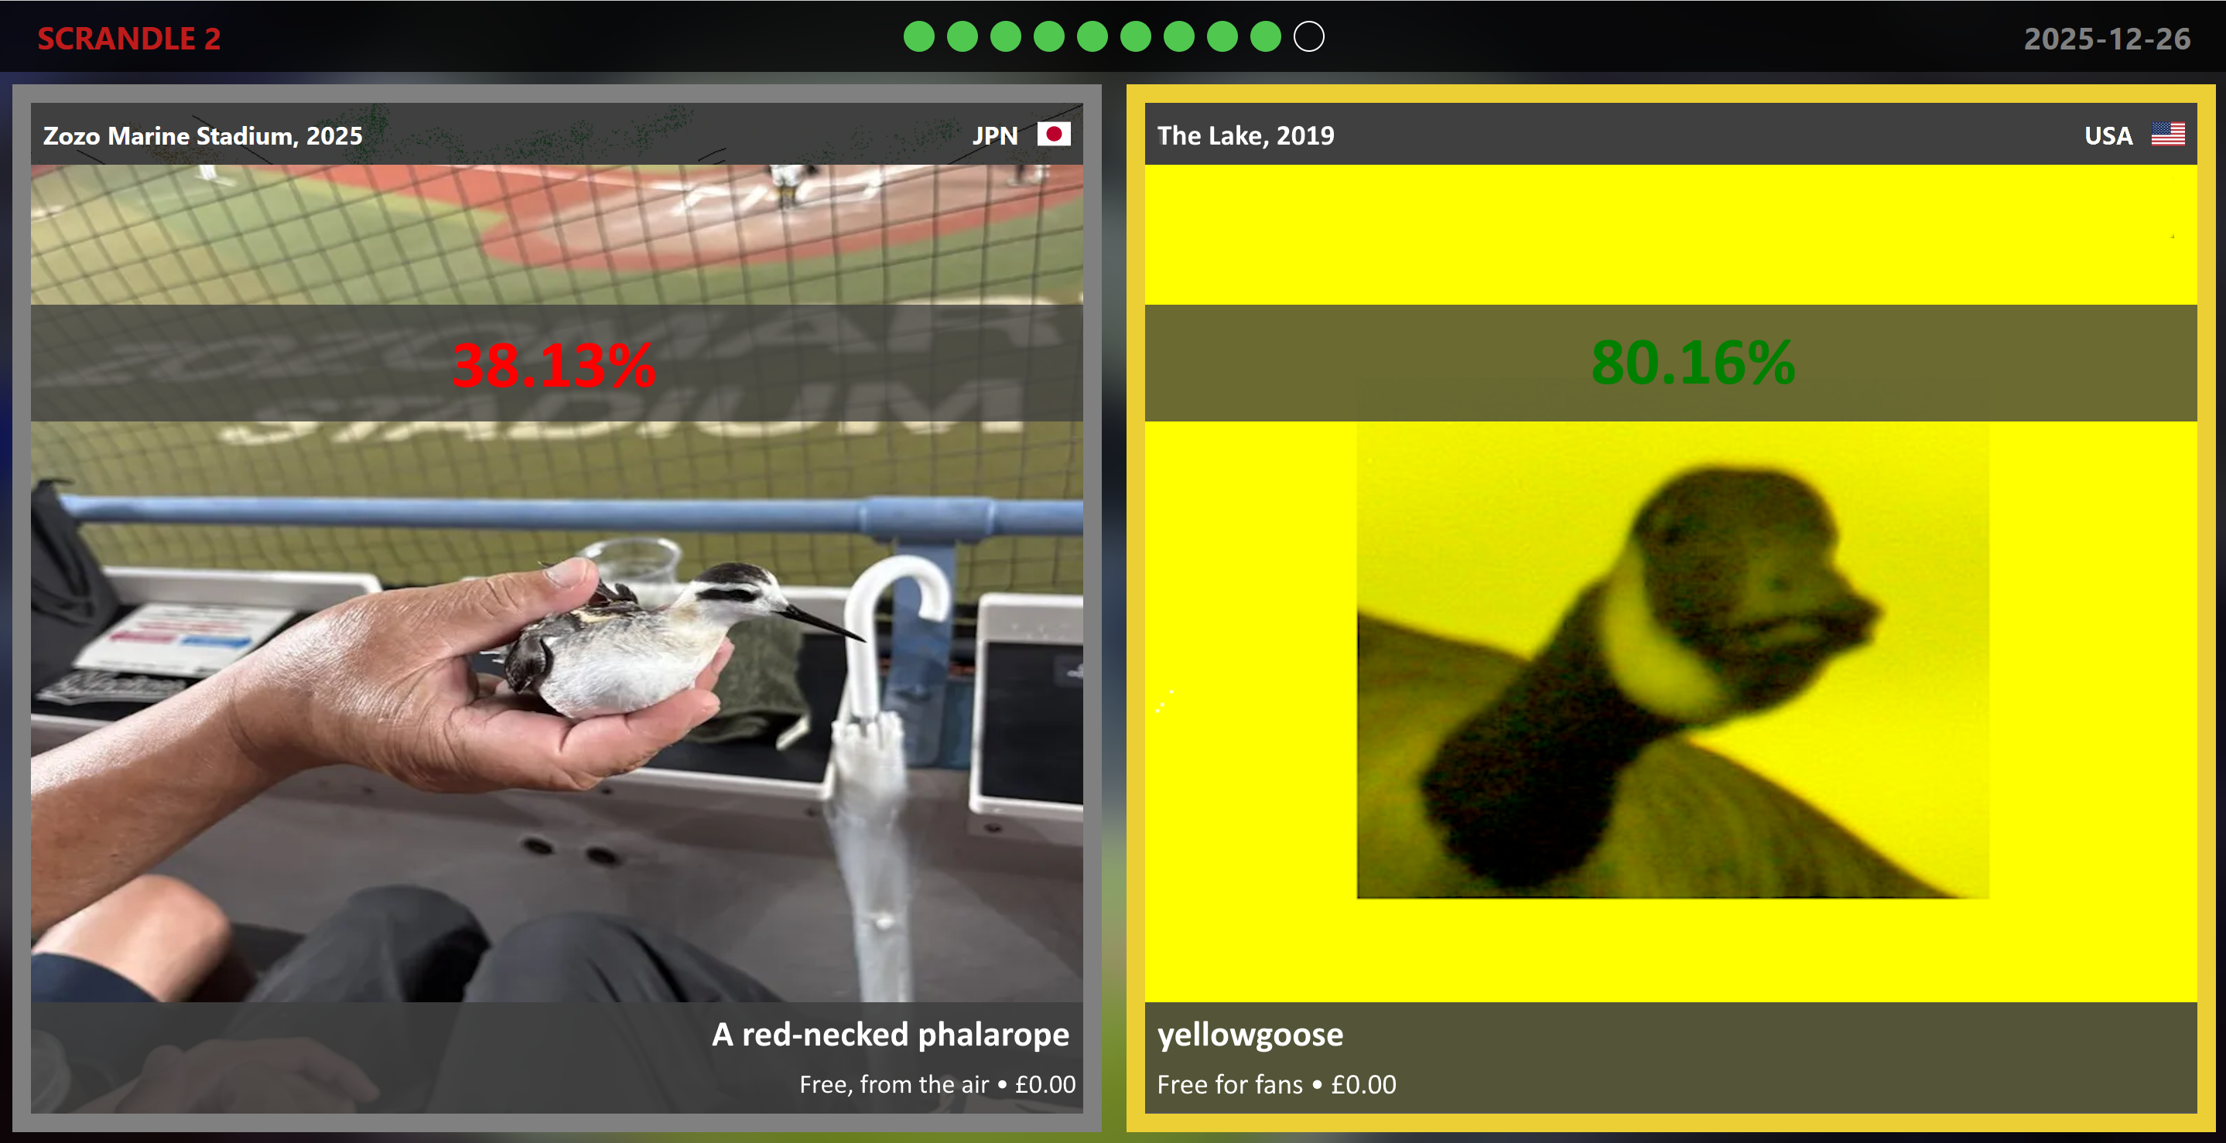
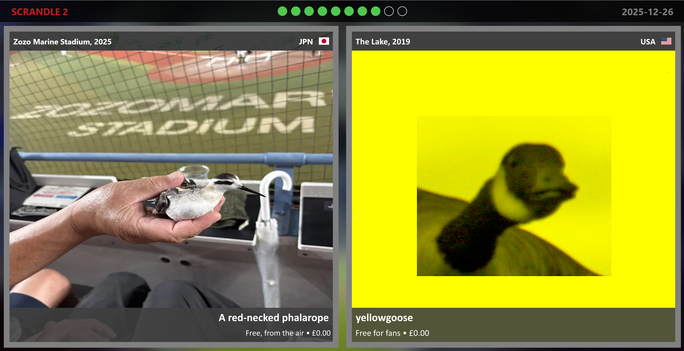
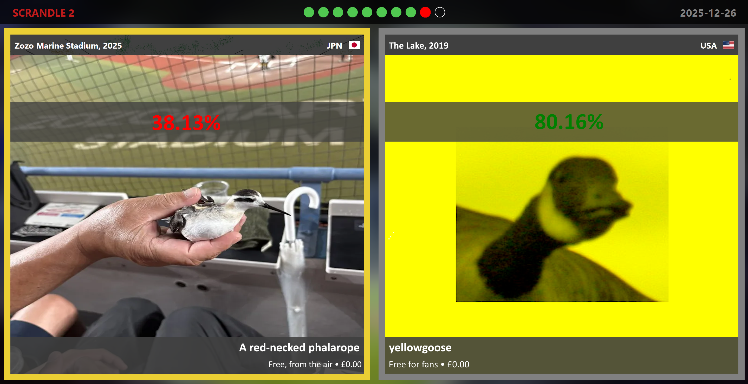

Slide 9


Slide 10


Slide 11
Don’t take the swine flu vaccine!

Slide 13


